Slide 1
18TH TRADE FAIR OIC (TFOIC) AND 12TH WEXNET EXHIBITION
29th November- 1st December 2024

Slide 2
Sequence of the Presentation
Overview of OIC Trade Fairs
Overview of WEXNET Editions
Main Objectives
Floor Plan
Brochure and Application Form
Marketing
Sideline Activities
Tentative Schedule of the Event
Conclusion
Partners/Stakeholders
Event at a Glance

Slide 3
Overview of OIC Trade Fairs
-The Islamic Centre for Development of Trade (ICDT) organizes biennial OIC Trade Fair in one of the OIC Member States.
-Main goal of the Fairs is to introduce products, industries, and services of the OIC Member States and raise the level of trade and investment opportunities among them.
1st OIC Trade Fair was held in Casablanca in 1984
2nd Casablanca 1986
4th Tunis 1990
15th Riyadh 2016
3rd Cairo 1988
5th Tehran 1994
6th Jakarta 1996
7th Tripoli 1998
8th Doha 2000
9th Sharjah 2002
10th Manama 2005
11th Dakar 2007
12th Cairo
13th Sharjah 2011
14th Tehran 2013
17th Dakar 2022
16th Baghdad 2019
Exceptional Fair Kuwait 2018

Slide 4
Overview of WEXNET Editions
-WEXNET is the largest exhibition platform for women entrepreneurs in Pakistan.
-In WEXNET 2023, more than 300 exhibitors (women entrepreneurs) from across Pakistan participated in the event
WEXNET formalized structure created by EPB in 1999
2001 Karachi
2002 Karachi
2005 Karachi
2010 Lahore
2014 Lahore
2015 Lahore
2003 Lahore
2006 Karachi
2022 Lahore
2023 Lahore

Slide 5
Main Objectives
Trade Relations
Strengthen trade relations amongst OIC members through economic diplomacy
Networking
Provide economic networking opportunity amongst OIC members – B2B, B2C and B2G
Exposure
Provide international exposure to Pakistani women entrepreneurs exhibiting at WEXNET
Event Profile
Broaden scope and profile of co-located events by enhanced local and international media coverage and increased footfall
Capacity Building
Highlight role of women in Islamic countries and build capacity of Pakistani women entrepreneurs

Slide 6
Event At A Glance (1/3)
Title | 18th TFOIC and 12th WEXNET 2024 (spot selling fair)
Venue | Expo Centre Lahore
Event Dates | 29th November, 2024 – 1st December, 2024 (Friday, Saturday and Sunday)
Theme | Women Empowerment through Entrepreneurship
Products in Focus | Textiles, leather & leather products, handicrafts, footwear, furniture, surgical instruments, pharmaceuticals, food products, cosmetics, crockery, marble & granite, IT and other services and any other product
No. of Halls | All 3 Exhibition Halls along with Auditorium 1 & 2, Foyer area of the Convention Center
Nature of Event | 1st Day for B2B/G2G 2nd and 3rd days for B2B and B2C (open to public)

Slide 7
Event At A Glance (2/3)
Participants | Women Entrepreneurs and exhibitors from OIC member countries
Nature of Exhibition | Multi-sectoral / General Product Category
Side line Activities | Pak-Africa-Middle East Business Forum OIC Asia Investment Promotion Agencies Policy Forum Training Workshop on Certification in Halal Products and Presentation of OIC Halal Economy Report Food Festival
Others Activities | Inaugural Dinner, Soft Launch

Slide 8
Event At A Glance (3/3)
Facilities provided by Pakistani side | Space for stall construction Transportation (pick and drop from designated hotels to the venue) Facilitation for booking of rooms in hotels and securing corporate rates for the exhibitors Arranging B2B/B2C/B2G Meetings Marketing of the event in Pakistan Mobilizing the Trade Officers of Pakistan posted in OIC member/observer states for marketing the event alongside ICDT Participation in Seminars/Workshops Overall coordination and facilitation for the event

Slide 9
Partners/Stakeholders
18th Trade Fair OIC
Islamic Centre for Development of Trade (ICDT)
Ministry of Commerce
Ministry of Foreign Affairs
Trade Development Authority of Pakistan
Pakistan’s Missions/TIOs in OIC countries
OIC Missions in Pakistan
12th WEXNET
Trade Development Authority of Pakistan
Trade Bodies (Women Chambers and Associations)
Women entrepreneurs

Slide 10
Floor Plan
HALL 1
HALL 2
HALL 3
Auditorium 1 & 2
Exhibitors from OIC Member States
Women Entrepreneurs – Pakistan
Food Festival
Sideline Activities
Hall Space
4,000 sqm
Hall Space
4,000 sqm
Hall Space
4,000 sqm
Auditorium 1 Capacity
820 seats
Stall Capacity
100 stalls
Stall Capacity
100 stalls
Auditorium 2 Capacity
200 seats
Per stall space
9 sqm
Per stall space
9 sqm
Foyer Area Capacity 300 seats
*** Promotional stalls to be given to government departments/agencies, NGOs, Int’l Development partners, banks/financial institutions, investment agencies etc.

Slide 11
Floor Plan For OIC Exhibitors
Galleries to be used as networking areas (Total No. of Stalls 100)

Slide 12
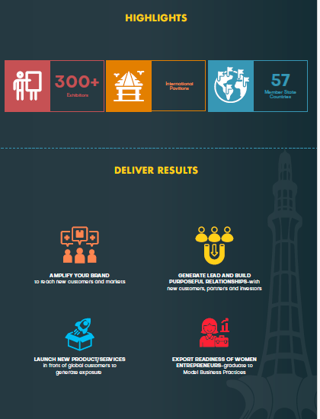
Brochure (1/2)

Slide 13
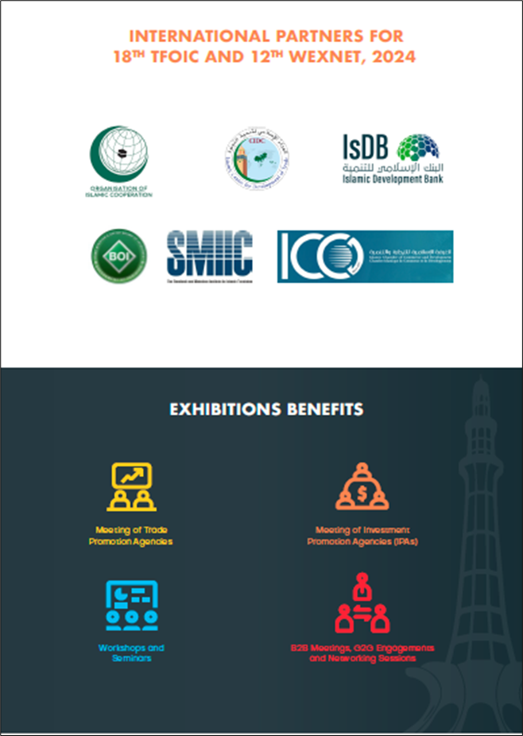
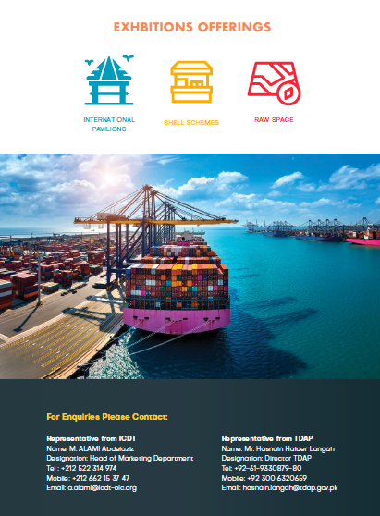
Brochure (2/2)

Slide 14
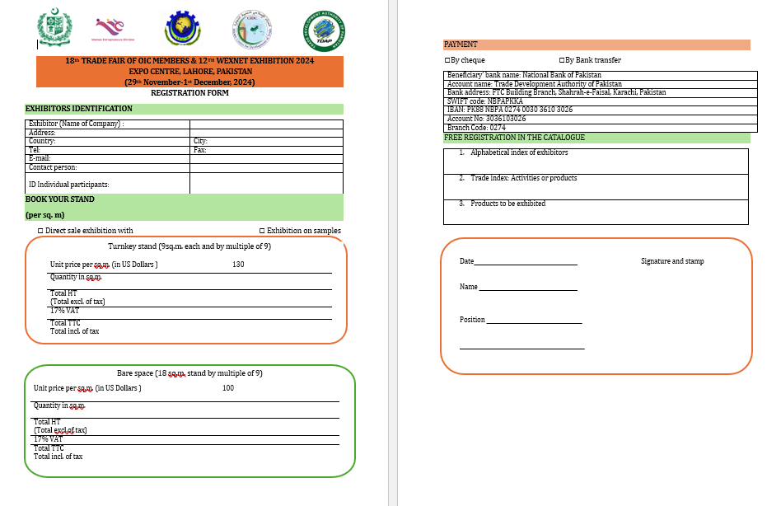

Slide 15
Marketing
International Marketing To OIC Member States By ICDT
International Marketing Through Trade Missions Abroad
Pakistan Pavilion and WEXNET Local Marketing Through TDAP Local Marketing Team & POs

Slide 16
Sideline Activities (Proposed by ICDT)
Pakistan - Africa- Middle East Business Forum
(1st Dec, 2024)
OIC Asia IPA Policy Dialogue Forum (30th Nov, 2024)
Training Workshop On Certification In Halal Products And Presentation of OIC Halal Economy Report
(30th Nov, 2024)

Slide 17
Tentative Schedule of the Event (1/2)
S. No. | Day | Date | Event | Comments
1 | One week before the event | 23rd November, 2024 | Soft Launch | PR/Marketing event for creating awareness. Influencers, bloggers and prominent personalities will be invited.
2 | Eve of the event | 29th November, 2024 | Inaugural Dinner | Soft inauguration on the evening of the event.
3 | DAY 1 | 29th November, 2024 | Ribbon cutting, high profile meetings | Exclusive B2G and High Profile engagements.

Slide 18
Tentative Schedule of the Event (2/2)
S. No. | Day | Date | Event | Comments
4 | DAY 2 | 30th November, 2024 | Training Workshop on Halal Certification and Presentation on Halal Economy Report by ICDT | To be organised by ICDT in collaboration with SMIIC (Standards and Metrology Institute for Islamic Countries)
5 | DAY 2 | 30th November, 2024 | OIC Investment Promotion Agencies Policy Forum | To be organised by ICDT in collaboration with BOI.
6 | DAY 3 | 1st December, 2024 | Pak-Africa-Middle East Business Forum | To be organised by ICDT in collaboration with FPCCI.
7 | DAY 1, 2 & 3 | 29th November- 1st December 2024 | Food Festival | TBD

Slide 19
Conclusion
ICDT is the focal organization for booking / allocation of stands from Exhibitors of OIC Member States.
TDAP accounts details are provided for collection of the Participation Fee in the Application Form.
Website for the event has been launched by ICDT - https://icdt-tradevents.org/en/18thtfoic/
Brochure, Application Form, Floor Plan and Exhibitor’s guide are available on the website link shared
OIC Missions in Islamabad are requested to also encourage the Women Entrepreneurs from their respective countries to participate in the event.

Slide 20
Conclusion (2/2)
Representative from ICDT for Space Booking: Name: M. ALAMI Abdelazi Designation: Head of Marketing Department Tel: +212 522 314 974 Mobile: 00212 662 15 37 47 Email: a.alami@icdt-oic.org
Representative from TDAP for Queries:
Name: Hasnain Haider Langah Designation: Director TDAP Tel: +92 61 9330879 80 Mobile: +92 300 6320659
Email: hasnain.langah@tdap.gov.pk
Cut off date for booking of space is 15th October 2024

Slide 21
THANK YOU

